Slide 1
Traceability
By: Evan and Matt

Slide 2
Reasons for Traceability
Change Impact Analysis
Coverage Analysis
Product Status Analysis
Persisting Relationships
Testing Optimization

Slide 3
Traceability Matrices
Table Format
Two-Way Traceability
Requirement and Code Identifiers
Traceability Tools

Slide 4
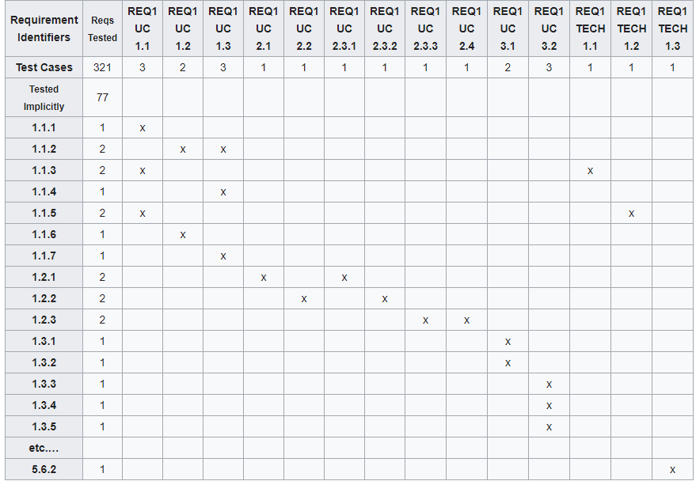
Example Matrix

Slide 5
Tools (Most Requirements Managers)
Rational Doors (IBM)
Modern Requirements
ReQTest
HelixALM

